Slide 1
SAFER
Action Plan
Overview

Slide 2
What are we trying to prevent?
Intoxication
Harm related to intoxication

Slide 3
Action Plan Components
Enforcement operations (including tools
that focus on party host)
Maximizing the visibility of enforcement
  Student communication plan
Management plan
Notes:
The comprehensive strategy that Bob briefly highlighted is based on proven practices in the general population that we in a college/community environment. The enforcement operations demonstrate their greatest deterrent effect when they are highly visible. Students being the target population in which we would like change to occur are a difficult group to reach through normal media routes. Therefore, the visibility plan needs to creative in its methods and implementation to reach students
The management plan lays out a focused strategy for the planning and implementation to take place and will be discussed in detail after lunch where we can learn from the experiences of the first Safer cohort

Slide 4
Safer Action Plan for
Off-campus parties
Student Visibility Campaign
Compliance Checks
DUI Check Points
Party Patrols

Slide 5
Enforcement Operations
Compliance Checks
Minor decoy operations
Visibility post operation
DUI Check Points
Highly visible
Large and small DUI and
Party Patrols
Focus on Party host
Enhanced by local policies (RCO)
Saturation patrols
Highly visible

Slide 6
Enforcement Operations
Conduct a minimum of nine operations listed below in any combination
  DUI Checkpoints
  Compliance checks
  Party patrols*
Assess existing enforcement options and adopt local ordinance to support party patrols
Align visibility to support enforcement

Slide 7
Response Cost Ordinance
(Policy example)
Benefits:
  Enforcement less costly
  Easily administered (e.g. similar to parking ticket)
  Triggered by 2nd response (up to 1 year window
  Fee / fine increases with each offense
  Party host(s) and landlords held accountable
  Violations can be reported to code compliance for further investigation

Slide 8
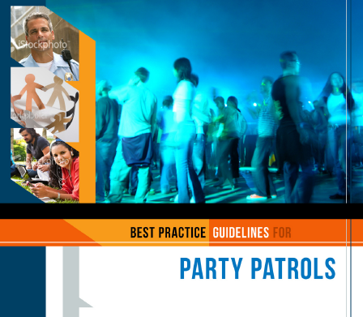

Slide 9
Visibility Campaign
Align messaging with enforcement activities (deterrent effect)
Students target audience
How do students get their information?
  Moving target
  Required being innovative
  Dosage important

Slide 10
Student Visibility Components
Letter from the President
Safer Party Brochure
Safer Website
3 Email Reminders
2 Campus Newspaper Articles
3 Outreach materials

Slide 11
Management Plan
Overview
Planning meeting #1
Planning meeting #2
Moving to Implementation
Party Patrol ‘Pilot’
Readiness meeting
Implementation
Mid- Course Correction meeting
Notes:
You all have had a chance to review and possibly discuss the Safer management plan overview during the lunch break. Today we would like to discuss the plan in broadly and concentrate on more specific elements of the two planning meeting and what is needed to prepare for those events.

Slide 12
Practical Significance from Safer Project
At each campus, 900 fewer students drinking to intoxication at off-campus parties and 600 fewer getting drunk at bars/restaurants during the fall semester at intervention schools relative to controls.
Equivalent to 6,000 fewer incidents of intoxication at off-campus parties and 4,000 fewer incidents at bars & restaurants during the fall semester at Safer intervention schools relative to controls

Slide 13
Action Plan
This is what we know: If you implement the action plan as designed you can get some effect
The more enforcement and visibility the greater the effect (dosage)
And the implementation strategy can be flexible, based on local conditions

